Slide 1



The Effects of Core Geometry Manipulation of 3D Printed Rocket Fuel
Daniel Rust
Mentor: Dr. John Rajadas
Daedalus Astronautics
NASA Space Grant Symposium
(University of Arizona) – April 14, 2018

Slide 2
What I have Done
Overview
Production of samples
  Modeling
Production results
Testing of fuel grains
Final thoughts

Slide 3
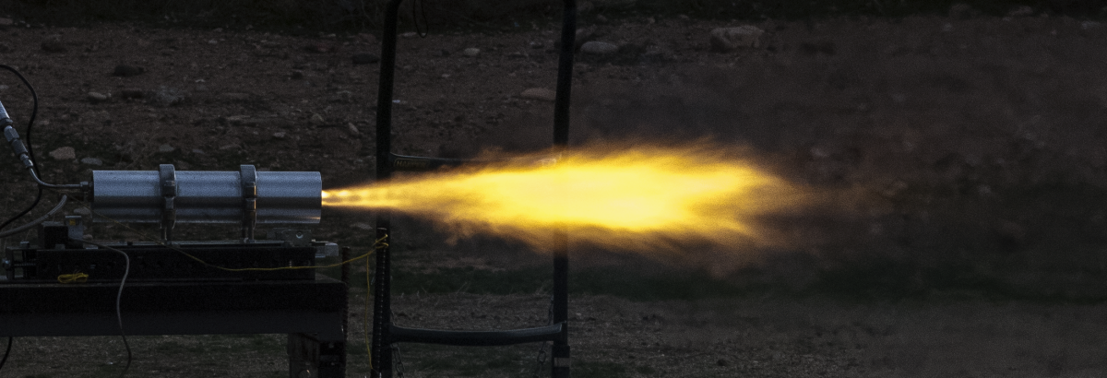
3D printed Rocket fuel
Three types of Rocket fuel: solid, liquid, and hybrid
Hybrids offer unique opportunity to 3D print fuel
Standard Hybrid fuel is Hydroxyl-terminated polybutadiene (HTPB)
3D printed Acrylonitrile butadiene styrene (ABS) alternative
  Not as good as HTPB
  Complex Geometry of core could alleviate this

Slide 4
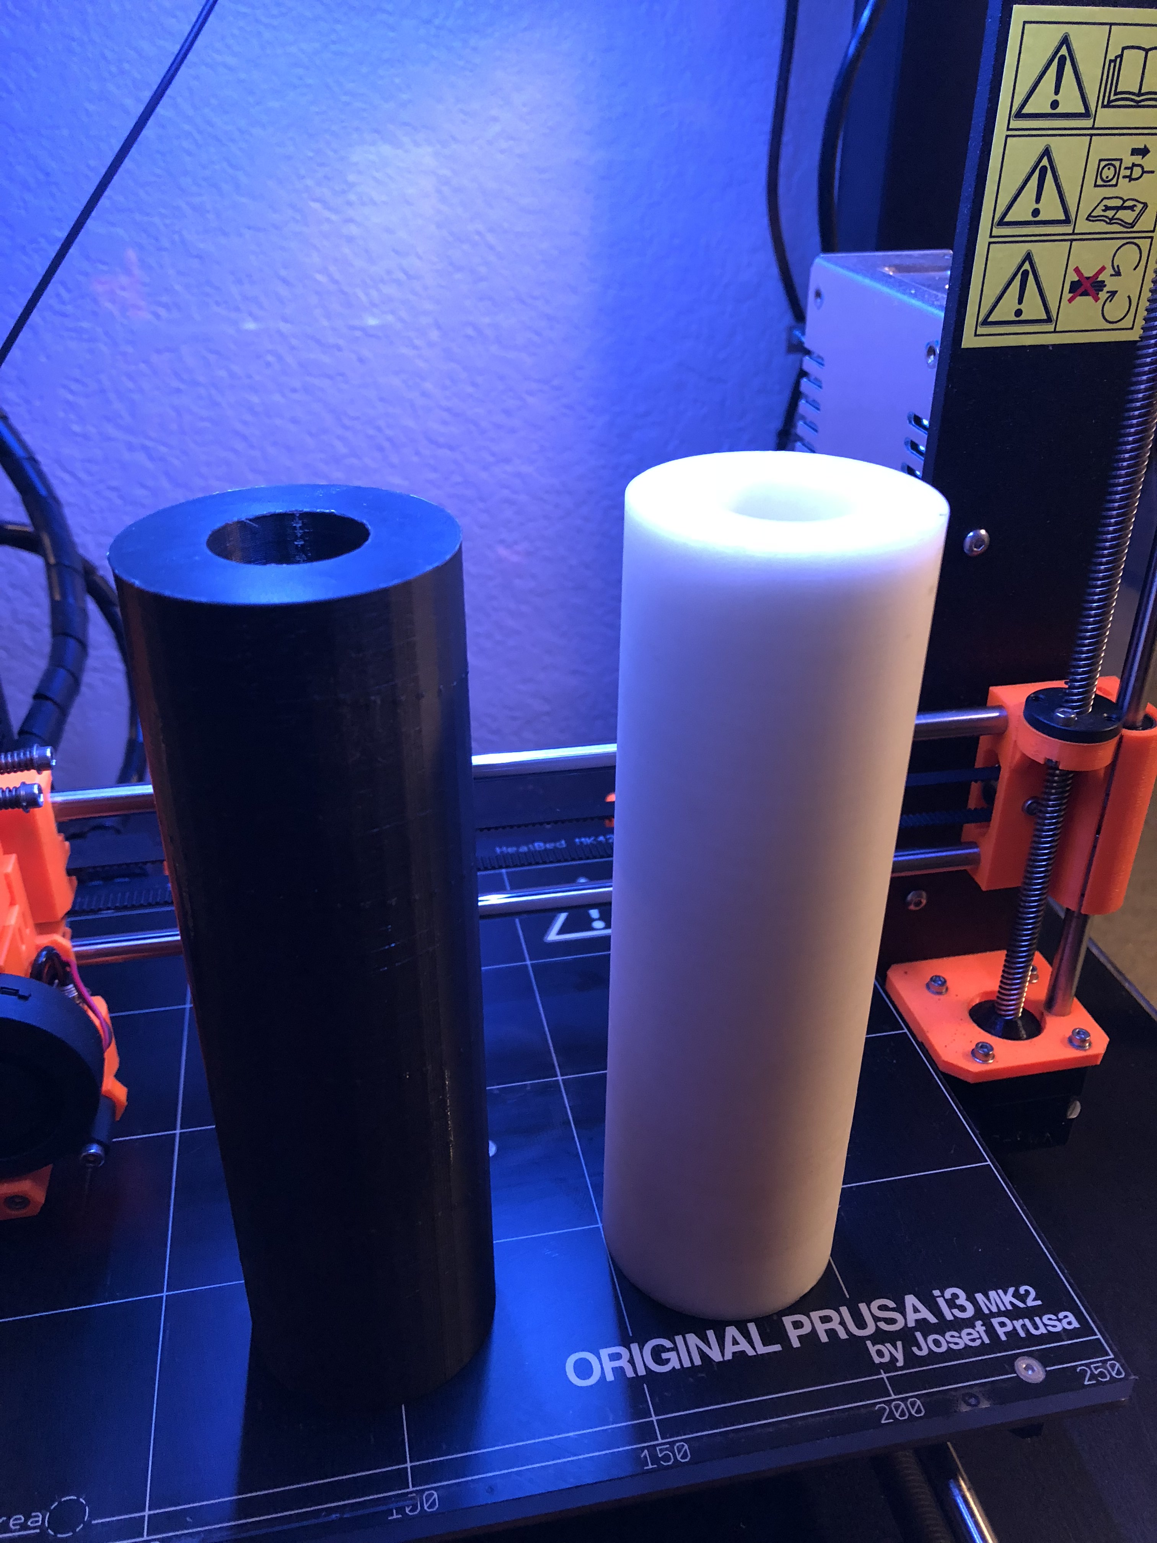
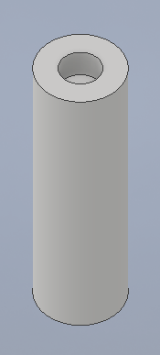
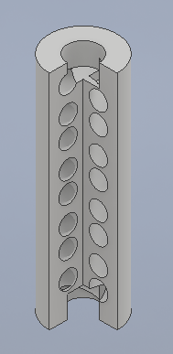
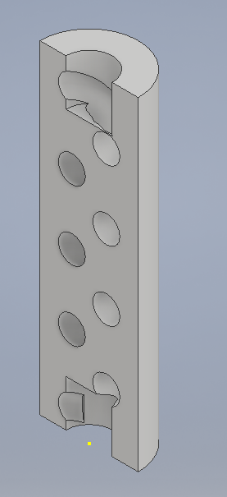
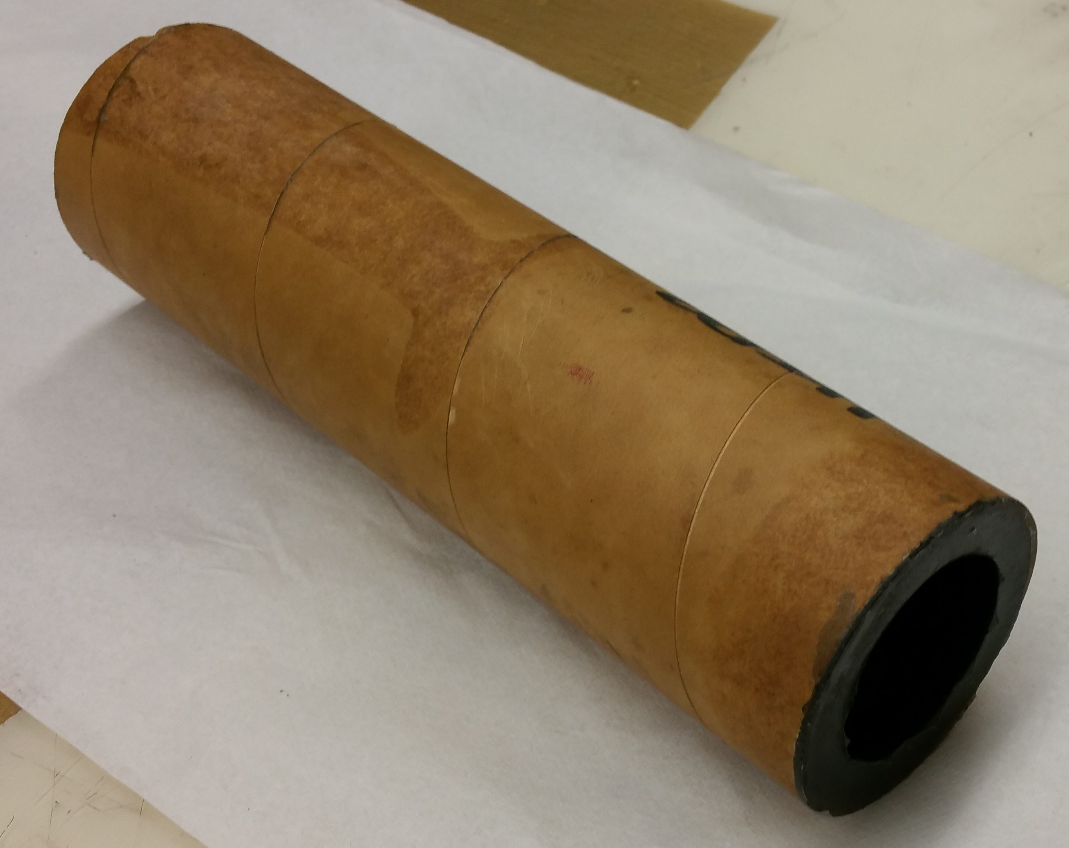
Production of Samples
ABS 3D printed grains
Single and double helix core geometry
SoildWorks modelling
3D printing: 10+ hours
Post processing in Acetone

Slide 5
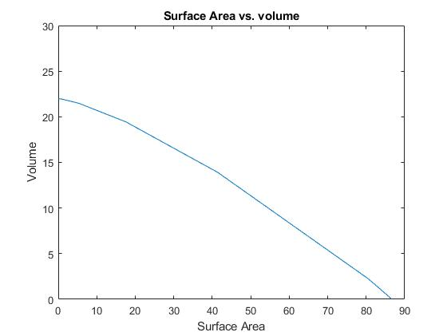
Production of samples
Modelled in MATLAB for maximizing volume and surface area.
Conclusion:
  .2 in Helix radius
  2 rotations
  2 in pitch
  .2 in circumference of helix

Slide 6
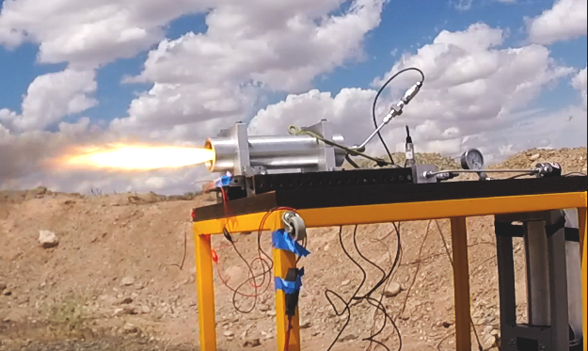
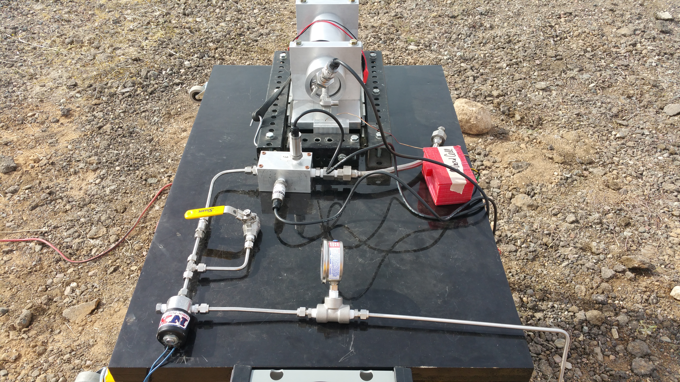
Testing of Fuel Grains
Testing:
  12 test fires: 3 HTPB grains, 3 ABS straight core, 3 ABS single helix, 3 ABS double helix.
  Regression rate, and thrust measurements
Testing has been a struggle
  National shortage of Nitrous oxide (oxidizer)

Slide 7
Conclusion and Recommendations
Production Process
  Longer and harder than anticipated
A combination of grains HTPB and ABS may be a viable option.
  ABS skeleton and HTPB filling.
Future testing
  Possible other cores
  Multi-material 3D Printed fuel
  Molding

Slide 8
Thank You
Any Questions?

